Slide 1
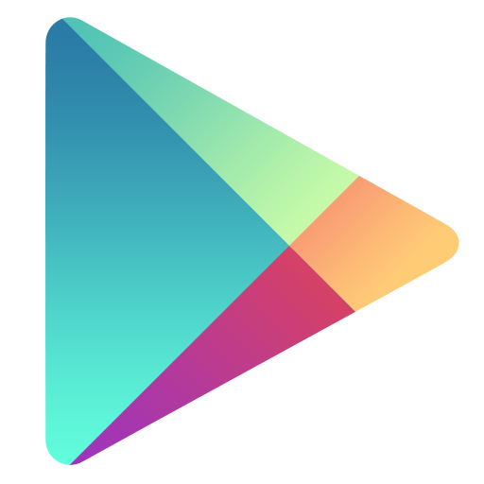
GOOGLEPLAY
DATA ANALYSIS

Slide 2
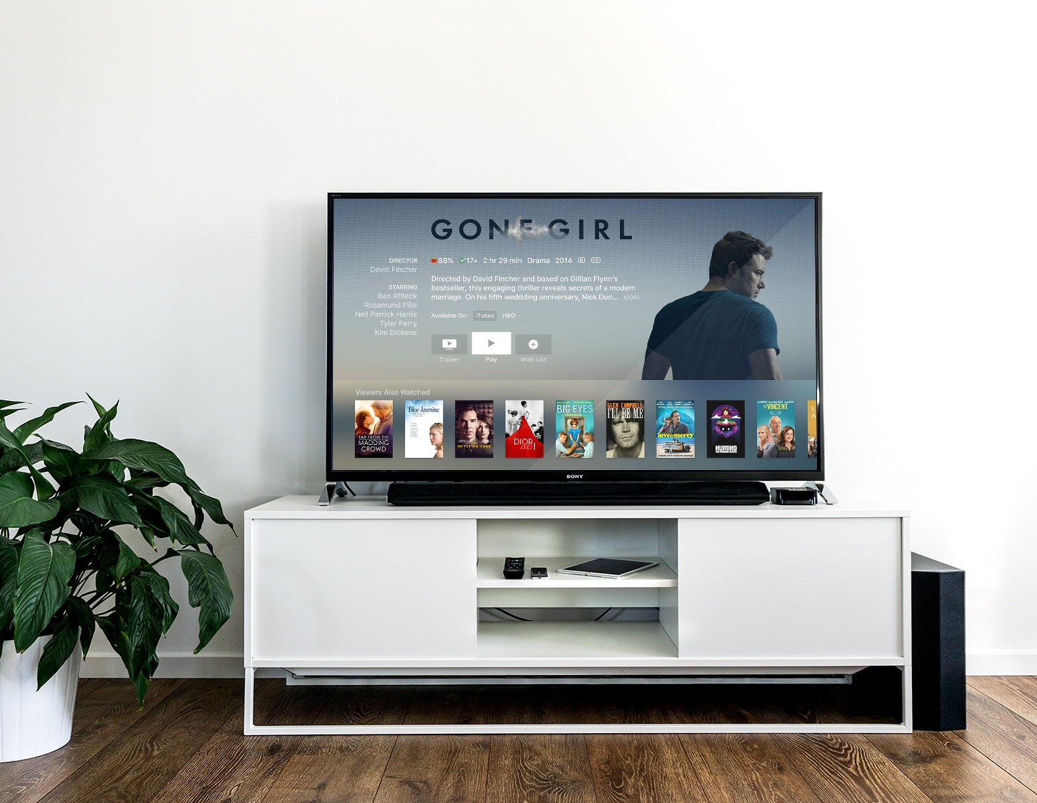
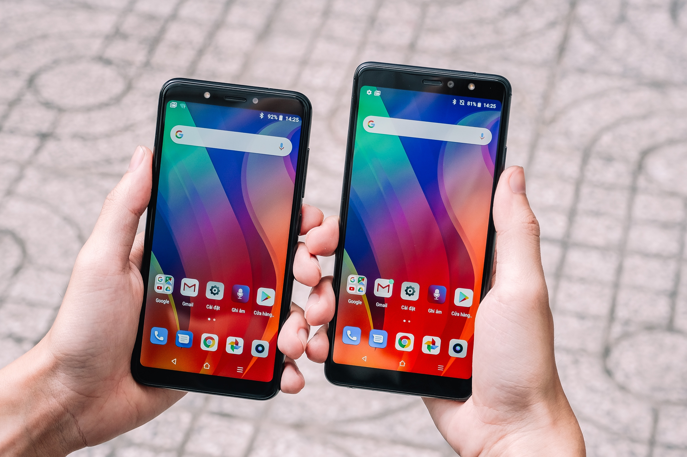

GOOGLE PLAY STORE
OVERVIEW
About Google Play Store
Google Play, which was originally born and referred to by Google as the ‘Android Market’, is Google's official store and portal for Android apps, games and other content for your Android-powered phone, tablet or Android TV device. Just as Apple has its App Store, Google has the Google Play Store. It's a huge place and it offers a lot of content to its users. Google Play is the one-stop-shop for Android apps, games, music, movie rentals and purchases, and e-books.
On Android Devices, the entire Google Play Store can be accessed through the Play Store app. Standard apps appear in the Android system tray, but Play Games, Play Music, Play Books, Play Movies & TV, and Play Newsstand are all libraries of downloadable content. Each has separate player apps that allow you to access your content

Slide 3

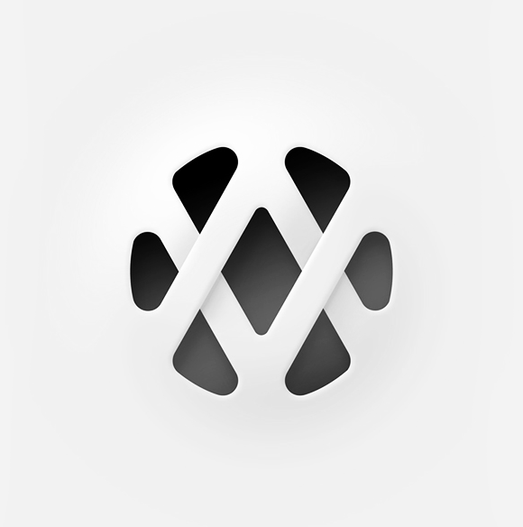
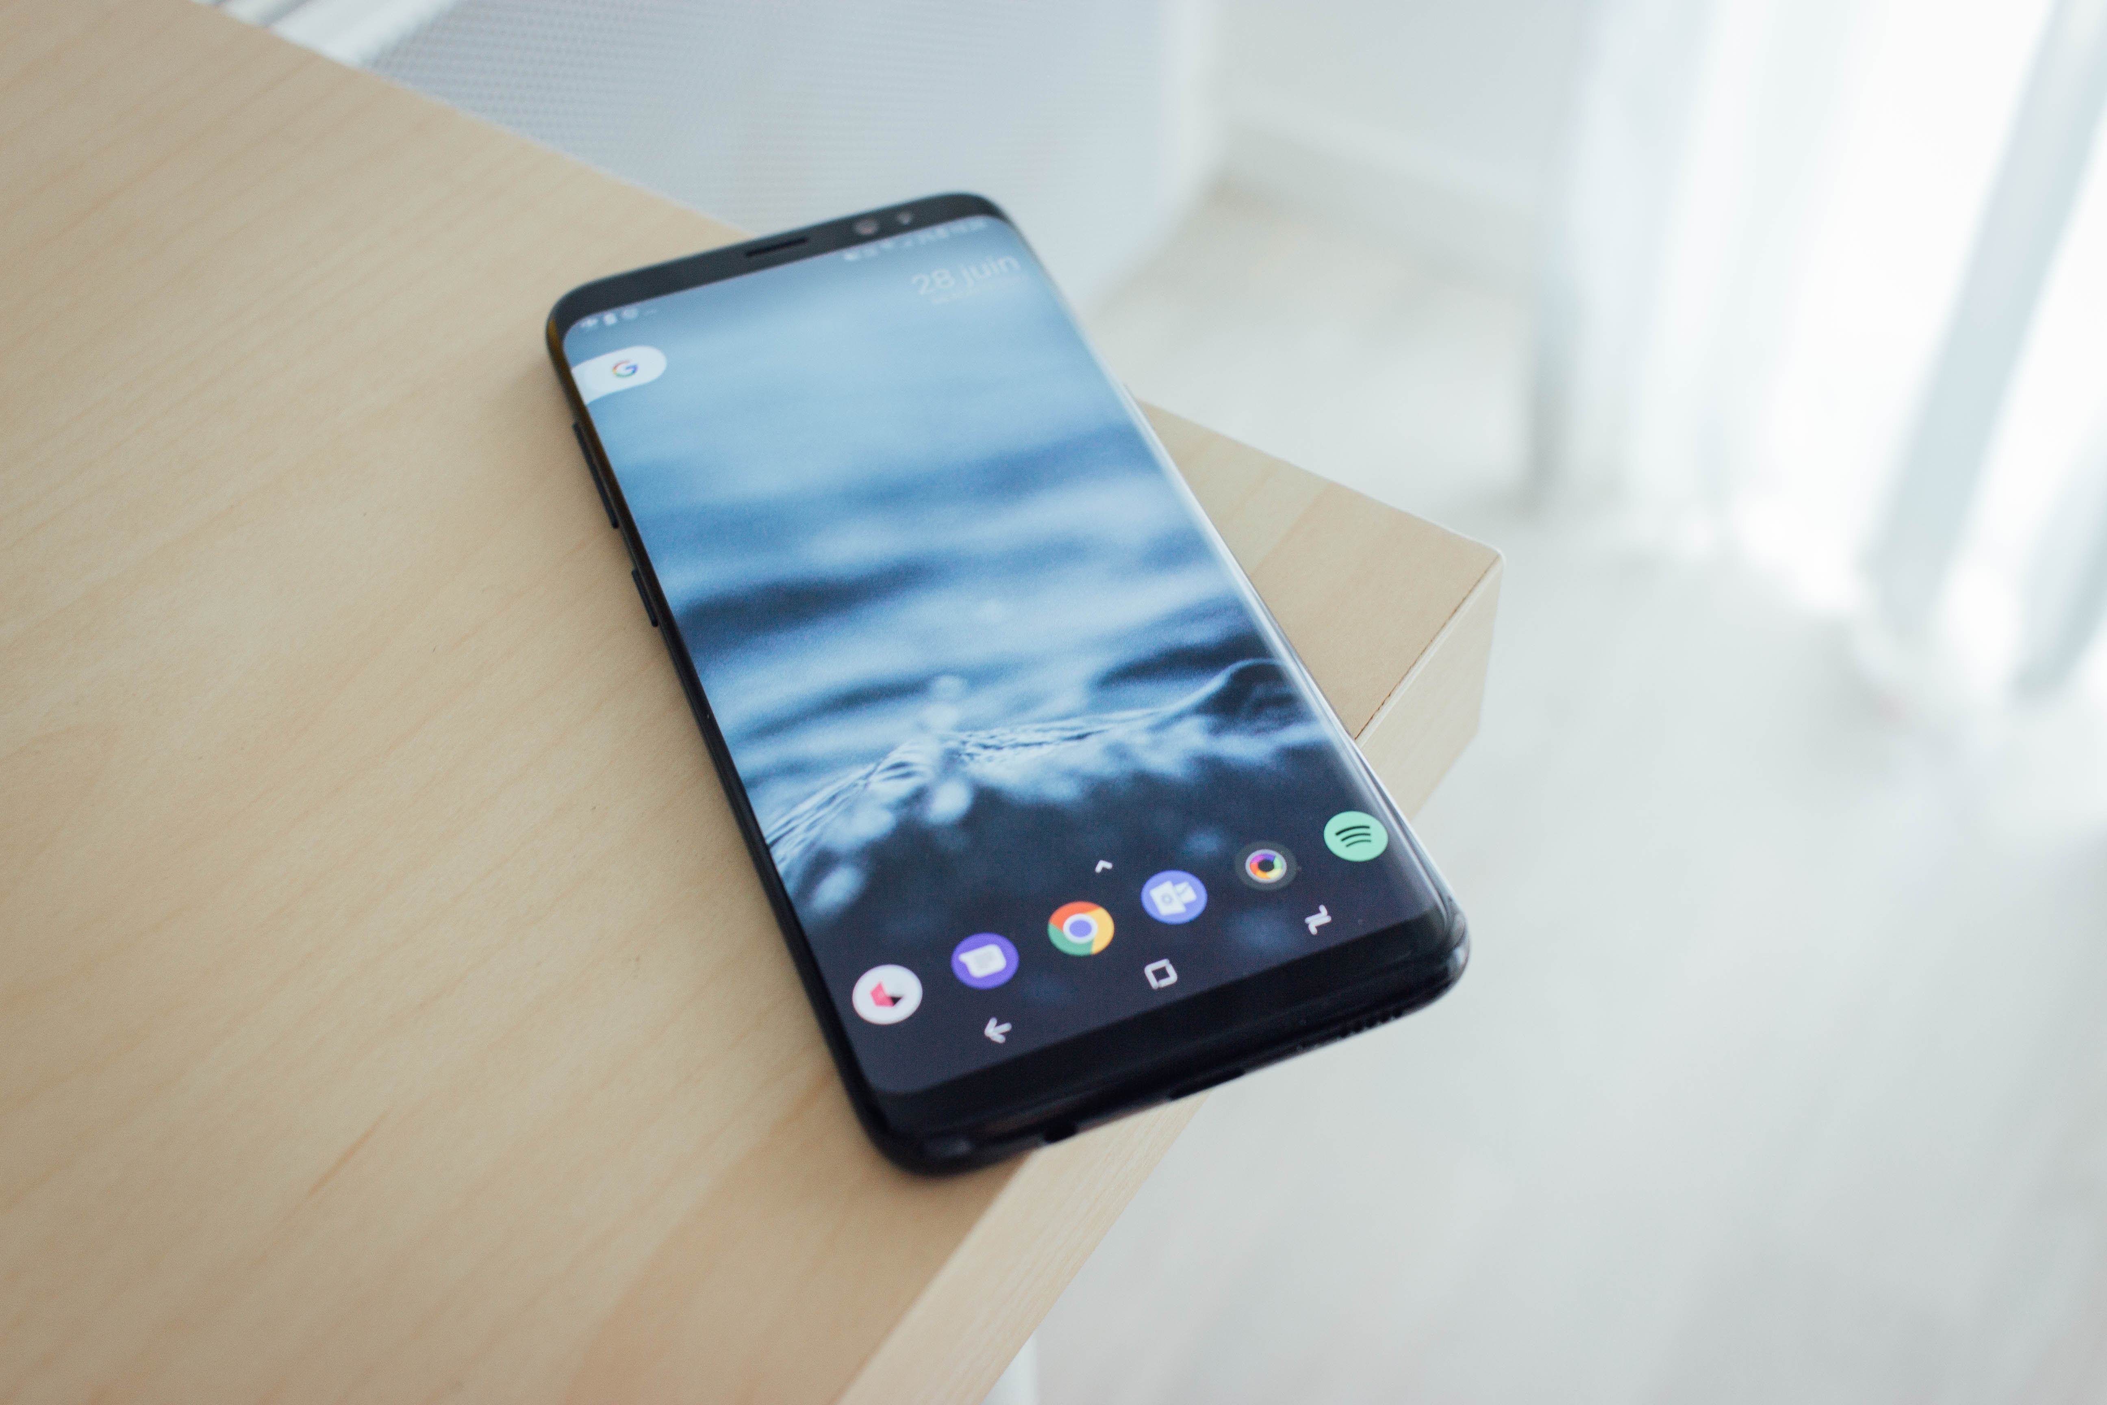

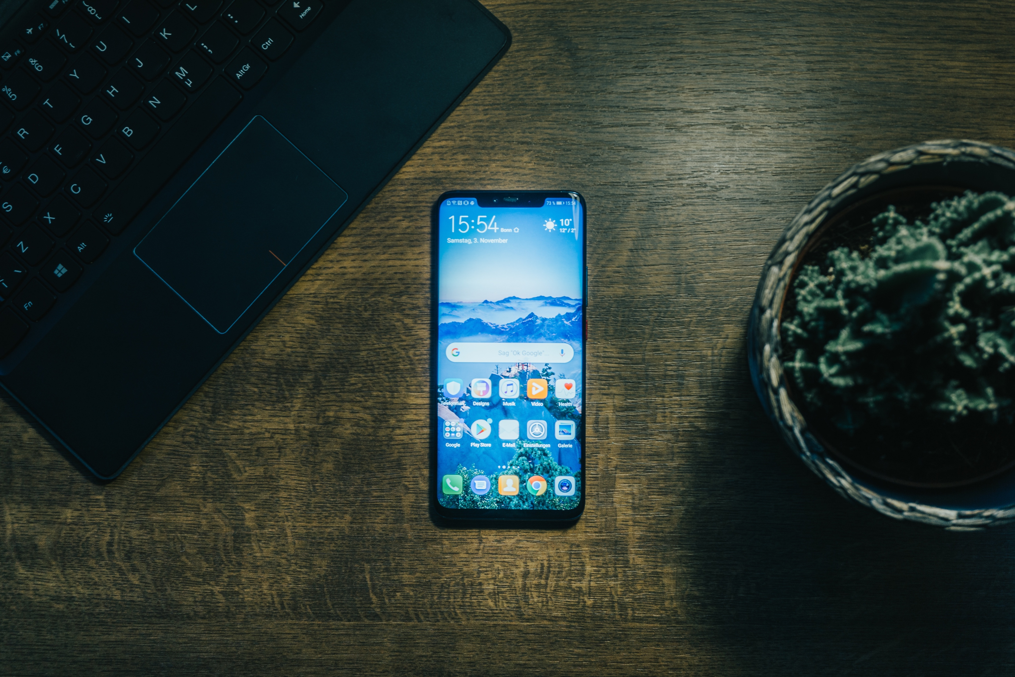



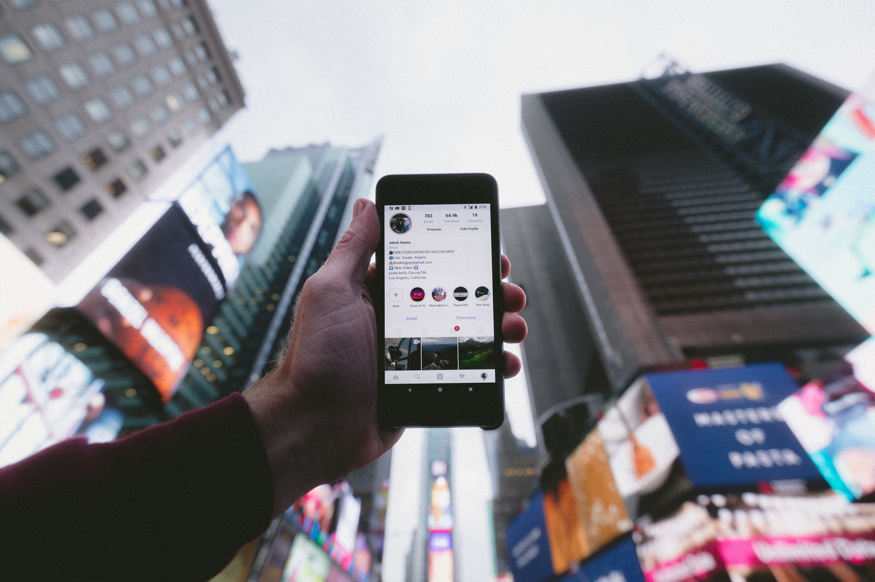
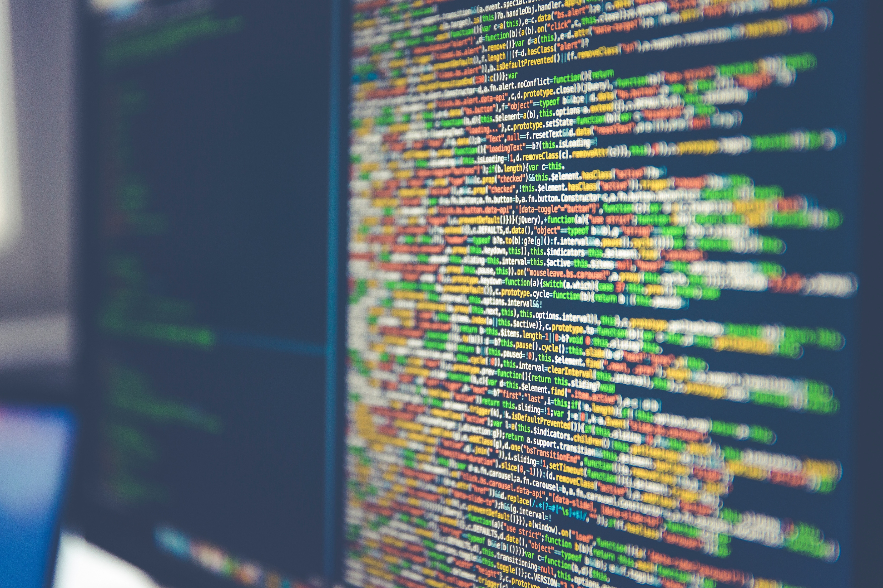


OUR TEAM

Slide 4


DIALA
SHARKAWI

Slide 5

NICHOLAS
WORTHY

Slide 6


JOE
FIORO

Slide 7


KENDAL
JAMES

Slide 8


GOOGLE PLAY STORE DATA
OUR GOALS
GOOGLE PLAY STORE DATA
Iterate on your ideas and improve the quality of your apps and games before you launch with powerful analytics that are broken down to the smallest details
APP DEVELOPER INSIGHTS
Browse and analyze user reviews to find trends and themes that will help you improve your app or game.
APP ANALYTICS
Understand and improve your app's performance and quality. See metrics in the areas of categories, ratings, downloads, and pricing.

Slide 9



GOOGLE PLAY STORE DATA
ANALYSIS
SIZE
RATING
PRICE
Effect of App size on downloads. How much of an effect does app size have on an app's download and install rate from the app stores?
Why Ratings and Reviews matter in Google Play Store and how your rating can affect your conversion rates on Google Play
Effect of App price on downloads. How much your App price can affect your conversion rates on Google Play

Slide 10

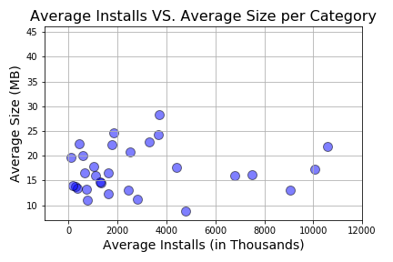

GOOGLE PLAY STORE DATA
SIZE
Cellular Data Limitations
With the larger app sizes (above 150mb), some carriers do not let users download the app over 3G or 4G. Therefore, users without WIFI may not
have access to the app on Google Play.
Size vs Downloads
There are no correlations between size and download rates. Developers can
expect to see the same download rate no matter the size of the app.
Google Play Store Limitations
Google Play does not display full app size if megabytes are over 99. Meaning, a developer
can produce and app that is 1000mb and the user will never know unless they
download the app The Play store will only label app size below 99mb.

Slide 11
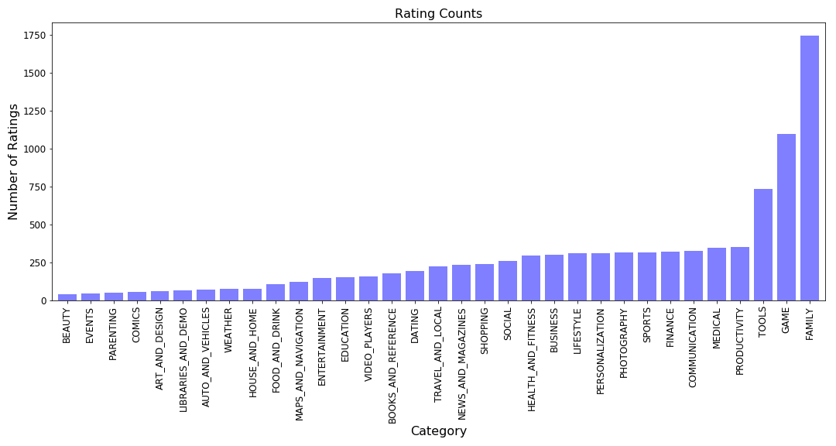


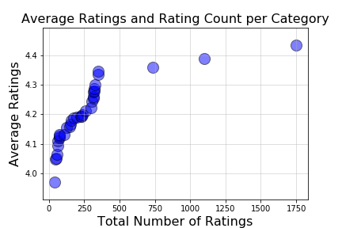

GOOGLE PLAY STORE DATA
RATINGS
Survey Bias
When analyzing Google Play Ratings and Reviews, we experience rating bias. This is because, with our data set, nothing is below 4 stars. Statically, with this number of apps, we should see lower ratings for some categories. This plays into the idea that people are afraid to give criticism.
Ratings vs Categories
In the scatter, we can see an interesting trend. Our three highest rated
Categories also have our highest total ratings. The highest average rating
As well as highest number of rating belongs to Family. The Family category
Holds any family-friendly apps.
Preferred Categories
There appears to be a lack of apps in several categories. Those categories are:
Beauty, Events, Parenting and Comics. We feel this is an untapped market
That should be targeted. There are not a high volume of apps in these categories,
This should make it easier to get your app seen.

Slide 12
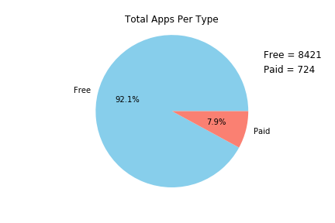
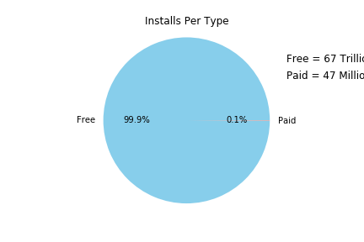

GOOGLE PLAY STORE DATA
PRICING
Free vs Paid
Most apps on the Google Play store are free and come with ‘in-app purchases.’ Most developers might find it necessary to keep the app free and add premium upgrades within the app.
Paid Apps
Most of the paid apps in the Google Play Store are inexpensive. The majority of apps cost about $1. Though some apps charge a premium around $400, they are sometimes bundled with the purchase of equipment like security cameras.
Free = 67 Trillion
Paid = 47 Million
Categories
It looks like certain app categories have more free apps available for download than
others. In our dataset, the majority of apps in Food & Drink, News and Magazines,
as well as Social categories were free to install. At the same time, Health & Fitness,
Travel & Local, Education, and Medical categories had the biggest number of paid apps
available for download.

Slide 13
GOOGLE PLAY STORE DATA
QUESTIONS

Slide 14
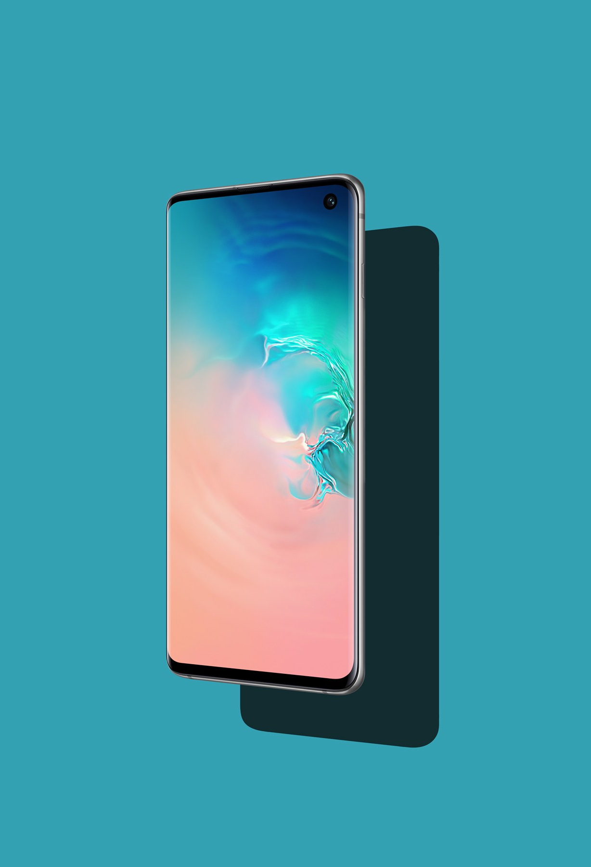
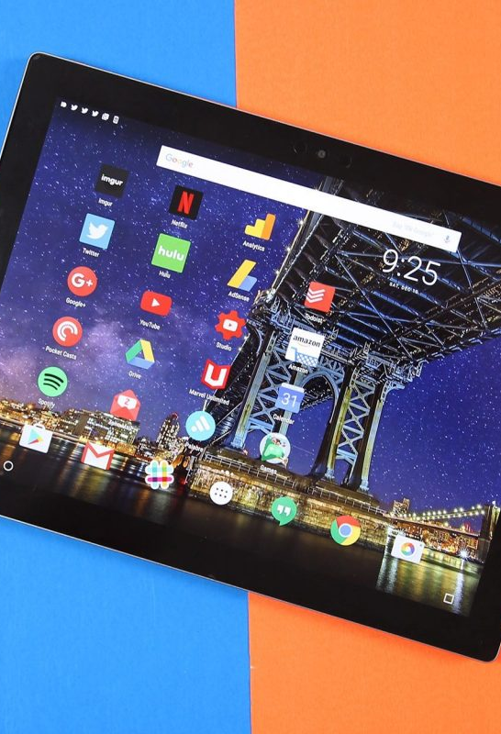
THANK YOU
GROUP 2
Saturday April 27th, 2019
UNCC DATA ANALYTICS BOOTCAMP
Diala Sharkawi
Nicholas Worthy
Joe Fioro
Kendal James

